Slide 1
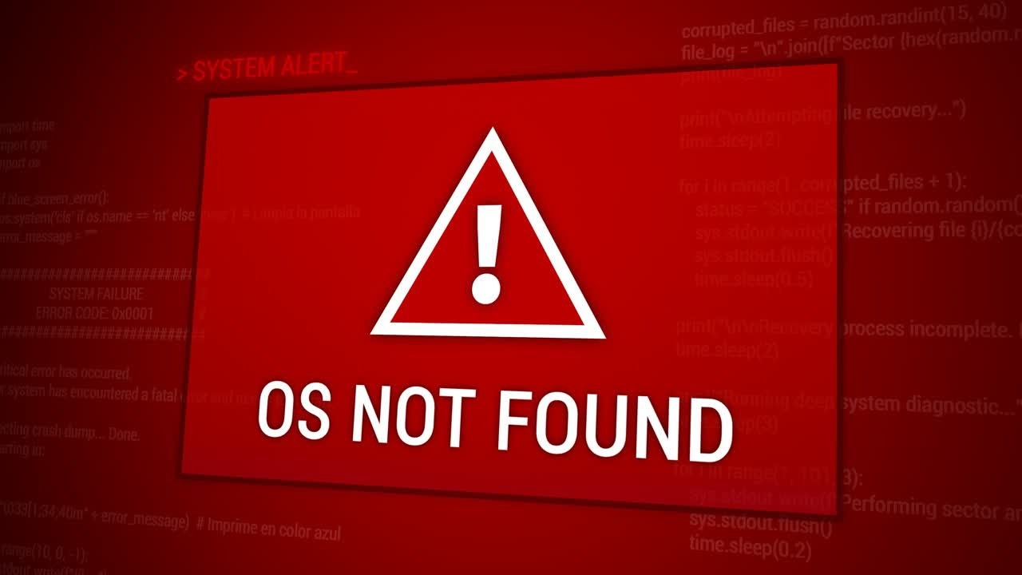
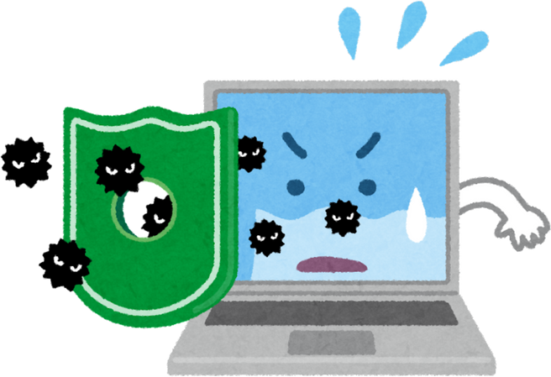

MULTIMEDIA UNIVERSITY, MALAYSIA
Operating System Vulnerabilities
ETHICAL HACKING AND PENETRATION TESTING
CCS6324 - 2530
Dr. Hafiz Adnan Hussain

Slide 2
DISCLAIMER
This course is designed to educate students on ethical hacking principles. The knowledge and techniques acquired must be used responsibly and not for any illegal or unauthorized activities.
Each student is solely responsible for their actions.
Do not investigate individuals, websites, servers or conduct any illegal activities on any system you do not have permission to analyze.
The course content has been developed in good faith, drawing from the author’s experience and reputable sources. While every effort has been made to ensure accuracy, the author does not guarantee absolute correctness. Students are encouraged to exercise discretion and actively engage in discussions by raising any questions or concerns during the course.
Notes:
Role of Security:
Security professionals play a crucial role in protecting systems and data. They employ ethical hacking techniques to identify vulnerabilities, ensuring that organizations can defend against potential threats and attacks.
Penetration Testing Methodologies:
Various methodologies guide penetration testing, including PTES, OWASP, and NIST. These frameworks provide structured approaches that enhance security assessments, helping organizations establish effective defenses against cyber threats.
Categories of Penetration Tests:
Penetration tests can be categorized based on scope, such as black-box, white-box, and grey-box testing. Each category serves a unique purpose, ensuring comprehensive evaluation of security measures and vulnerabilities.
Legal Framework:
Ethical hackers must navigate a complex legal framework, ensuring compliance with laws and regulations to avoid legal repercussions while conducting penetration tests and vulnerability assessments.
Ethical Concerns:
Ethical considerations are paramount for penetration testers, as they must balance security practices with respect for privacy and integrity, ensuring that their actions do not harm individuals or organizations.
Learning Outcomes:
By the end of this week, students will grasp the fundamentals of ethical hacking, legal boundaries, and frameworks, empowering them to engage confidently in ethical hacking practices.

Slide 3
Learning Objectives
What You Will Learn?
Identify and analyze OS-specific vulnerabilities in Windows, Linux, and embedded systems
Understand privilege escalation techniques and exploitation methods
Apply hardening measures to protect operating systems
Detect and mitigate rootkit threats
Assess vulnerabilities in IoT and embedded devices
Implement countermeasures against OS attacks
Notes:
Role of Security:
Security professionals play a crucial role in protecting systems and data. They employ ethical hacking techniques to identify vulnerabilities, ensuring that organizations can defend against potential threats and attacks.
Penetration Testing Methodologies:
Various methodologies guide penetration testing, including PTES, OWASP, and NIST. These frameworks provide structured approaches that enhance security assessments, helping organizations establish effective defenses against cyber threats.
Categories of Penetration Tests:
Penetration tests can be categorized based on scope, such as black-box, white-box, and grey-box testing. Each category serves a unique purpose, ensuring comprehensive evaluation of security measures and vulnerabilities.
Legal Framework:
Ethical hackers must navigate a complex legal framework, ensuring compliance with laws and regulations to avoid legal repercussions while conducting penetration tests and vulnerability assessments.
Ethical Concerns:
Ethical considerations are paramount for penetration testers, as they must balance security practices with respect for privacy and integrity, ensuring that their actions do not harm individuals or organizations.
Learning Outcomes:
By the end of this week, students will grasp the fundamentals of ethical hacking, legal boundaries, and frameworks, empowering them to engage confidently in ethical hacking practices.

Slide 4
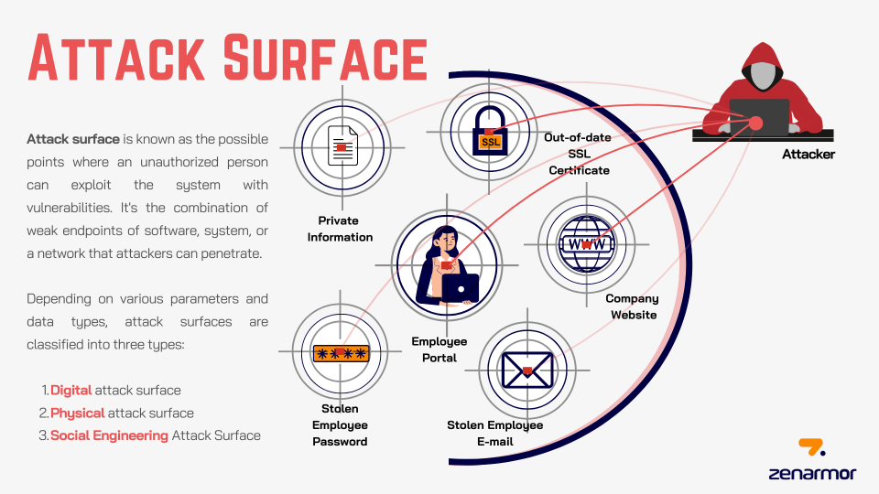
Notes:
Role of Security:
Security professionals play a crucial role in protecting systems and data. They employ ethical hacking techniques to identify vulnerabilities, ensuring that organizations can defend against potential threats and attacks.
Penetration Testing Methodologies:
Various methodologies guide penetration testing, including PTES, OWASP, and NIST. These frameworks provide structured approaches that enhance security assessments, helping organizations establish effective defenses against cyber threats.
Categories of Penetration Tests:
Penetration tests can be categorized based on scope, such as black-box, white-box, and grey-box testing. Each category serves a unique purpose, ensuring comprehensive evaluation of security measures and vulnerabilities.
Legal Framework:
Ethical hackers must navigate a complex legal framework, ensuring compliance with laws and regulations to avoid legal repercussions while conducting penetration tests and vulnerability assessments.
Ethical Concerns:
Ethical considerations are paramount for penetration testers, as they must balance security practices with respect for privacy and integrity, ensuring that their actions do not harm individuals or organizations.
Learning Outcomes:
By the end of this week, students will grasp the fundamentals of ethical hacking, legal boundaries, and frameworks, empowering them to engage confidently in ethical hacking practices.

Slide 5
Windows Operating System Vulnerabilities
1.1 Overview: Operating system vulnerabilities are weaknesses in the OS that allow attackers to perform unauthorized actions. Windows systems remain high-value targets for attackers due to their prevalence in enterprise environments. Vulnerabilities in Windows can be exploited through known Common Vulnerabilities and Exposures (CVEs), Misconfigurations, and Zero-day exploits.
1.2 Windows File Systems:
File Allocation Table (FAT):
Original Microsoft file system, supported by nearly all OSs
Most serious shortcoming: lacks file-level Access Control Lists (ACLs)
Cannot set permissions on individual files in multiuser environments
Creates vulnerabilities in shared system access
NTFS (New Technology File System):
First released as a high-end file system
Added support for larger files, disk volumes, and ACL file security
Feature: Alternate Data Streams (ADSs) - ability to hide information behind existing files
Intruders can hide exploitation tools and malicious files without affecting the file function or size
Detection methods available: Microsoft STREAMS.EXE
Note: There are many interesting visualizations available on the Internet. It's better to search both terms on Google Images for detailed information on FAT and NTFS.
Notes:
Role of Security:
Security professionals play a crucial role in protecting systems and data. They employ ethical hacking techniques to identify vulnerabilities, ensuring that organizations can defend against potential threats and attacks.
Penetration Testing Methodologies:
Various methodologies guide penetration testing, including PTES, OWASP, and NIST. These frameworks provide structured approaches that enhance security assessments, helping organizations establish effective defenses against cyber threats.
Categories of Penetration Tests:
Penetration tests can be categorized based on scope, such as black-box, white-box, and grey-box testing. Each category serves a unique purpose, ensuring comprehensive evaluation of security measures and vulnerabilities.
Legal Framework:
Ethical hackers must navigate a complex legal framework, ensuring compliance with laws and regulations to avoid legal repercussions while conducting penetration tests and vulnerability assessments.
Ethical Concerns:
Ethical considerations are paramount for penetration testers, as they must balance security practices with respect for privacy and integrity, ensuring that their actions do not harm individuals or organizations.
Learning Outcomes:
By the end of this week, students will grasp the fundamentals of ethical hacking, legal boundaries, and frameworks, empowering them to engage confidently in ethical hacking practices.

Slide 6
Windows Operating System Vulnerabilities (Cont’d)
1.3 Common Windows Vulnerabilities
Unquoted Service Path:
When a Windows service has an executable path without quotes and contains spaces, Windows attempts to execute files at different path intervals:
Example: C:\Program Files\Dummy Service\svc01.exe
Windows tries to execute:
C:\Program.exe
C:\Program Files\Dummy.exe
C:\Program Files\Dummy Service\svc01.exe
If an attacker can place a malicious Program.exe in C:\, the service will execute the attacker's code with service privileges (often SYSTEM).
Mitigation:
Always enclose executable paths in double quotes
Audit service configurations regularly
Monitor for unusual service behavior and command-line executions
Insecure Permissions:
Services, files, and registry keys with overly permissive access controls allow low-privilege users to modify critical system components.
Vulnerable Groups:
Everyone
BUILTIN\Users
NT AUTHORITY\Authenticated Users
Low-privilege users may exploit these permissions to:
Write malicious DLLs to system directories
Modify service executables
Alter startup configurations
Mitigation:
Apply least privilege principles to all file and registry permissions
Regularly audit Access Control Lists (ACLs)
Use tools like AccessChk to identify insecure permissions
Implement Group Policy Object (GPO) restrictions
Notes:
Role of Security:
Security professionals play a crucial role in protecting systems and data. They employ ethical hacking techniques to identify vulnerabilities, ensuring that organizations can defend against potential threats and attacks.
Penetration Testing Methodologies:
Various methodologies guide penetration testing, including PTES, OWASP, and NIST. These frameworks provide structured approaches that enhance security assessments, helping organizations establish effective defenses against cyber threats.
Categories of Penetration Tests:
Penetration tests can be categorized based on scope, such as black-box, white-box, and grey-box testing. Each category serves a unique purpose, ensuring comprehensive evaluation of security measures and vulnerabilities.
Legal Framework:
Ethical hackers must navigate a complex legal framework, ensuring compliance with laws and regulations to avoid legal repercussions while conducting penetration tests and vulnerability assessments.
Ethical Concerns:
Ethical considerations are paramount for penetration testers, as they must balance security practices with respect for privacy and integrity, ensuring that their actions do not harm individuals or organizations.
Learning Outcomes:
By the end of this week, students will grasp the fundamentals of ethical hacking, legal boundaries, and frameworks, empowering them to engage confidently in ethical hacking practices.

Slide 7
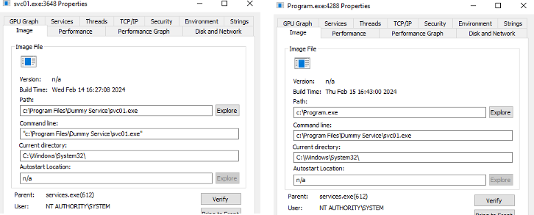
Windows Operating System Vulnerabilities (Cont’d)
An Example of Unquoted Service Path:
Notes:
Role of Security:
Security professionals play a crucial role in protecting systems and data. They employ ethical hacking techniques to identify vulnerabilities, ensuring that organizations can defend against potential threats and attacks.
Penetration Testing Methodologies:
Various methodologies guide penetration testing, including PTES, OWASP, and NIST. These frameworks provide structured approaches that enhance security assessments, helping organizations establish effective defenses against cyber threats.
Categories of Penetration Tests:
Penetration tests can be categorized based on scope, such as black-box, white-box, and grey-box testing. Each category serves a unique purpose, ensuring comprehensive evaluation of security measures and vulnerabilities.
Legal Framework:
Ethical hackers must navigate a complex legal framework, ensuring compliance with laws and regulations to avoid legal repercussions while conducting penetration tests and vulnerability assessments.
Ethical Concerns:
Ethical considerations are paramount for penetration testers, as they must balance security practices with respect for privacy and integrity, ensuring that their actions do not harm individuals or organizations.
Learning Outcomes:
By the end of this week, students will grasp the fundamentals of ethical hacking, legal boundaries, and frameworks, empowering them to engage confidently in ethical hacking practices.

Slide 8
Windows Operating System Vulnerabilities (Cont’d)
1.3 Common Windows Vulnerabilities (Cont’d)
System PATH Hijacking:
The Windows PATH environment variable specifies directories where executable files are searched. If a directory in the PATH is writable by low-privilege users, attackers can place malicious executables there.
Attack Scenario: If C:\CustomProgram is user-writable and appears in PATH before C:\Windows\System32, an attacker can create a malicious net.exe in C:\CustomProgram. When an administrator runs the net command, the attacker's version executes with elevated privileges.
Mitigation:
Restrict write permissions on all PATH directories
Avoid allowing low-privilege users to write to C:\, C:\Windows, or C:\Program Files
Monitor and log file creation in system directories
Regularly verify PATH configuration integrity
DLL Hijacking:
Applications load DLLs from multiple locations. If an attacker can place a malicious DLL in a location searched before the legitimate library, the malicious DLL loads instead.
Attack Scenario: If an application exe01.exe expects dll01.dll from C:\Windows\System32, but an attacker places a malicious dll01.dll in C:\CustomProgram (a directory searched first), the malicious version loads with the application's privileges.
Mitigation:
Validate DLL integrity using digital signatures
Use DLL search order safeguards
Load DLLs from system directories only
Implement Code Integrity policies
Notes:
Role of Security:
Security professionals play a crucial role in protecting systems and data. They employ ethical hacking techniques to identify vulnerabilities, ensuring that organizations can defend against potential threats and attacks.
Penetration Testing Methodologies:
Various methodologies guide penetration testing, including PTES, OWASP, and NIST. These frameworks provide structured approaches that enhance security assessments, helping organizations establish effective defenses against cyber threats.
Categories of Penetration Tests:
Penetration tests can be categorized based on scope, such as black-box, white-box, and grey-box testing. Each category serves a unique purpose, ensuring comprehensive evaluation of security measures and vulnerabilities.
Legal Framework:
Ethical hackers must navigate a complex legal framework, ensuring compliance with laws and regulations to avoid legal repercussions while conducting penetration tests and vulnerability assessments.
Ethical Concerns:
Ethical considerations are paramount for penetration testers, as they must balance security practices with respect for privacy and integrity, ensuring that their actions do not harm individuals or organizations.
Learning Outcomes:
By the end of this week, students will grasp the fundamentals of ethical hacking, legal boundaries, and frameworks, empowering them to engage confidently in ethical hacking practices.

Slide 9
Windows Operating System Vulnerabilities (Cont’d)
1.4 Windows Services and SYSTEM Account
Local System Account (SYSTEM):
Security Identifier: S-1-5-18
Most powerful account on a local system
Services running under SYSTEM have unrestricted system access
Exploiting SYSTEM-level services grants complete system compromise
Windows Service Control Manager (SCM):
Launches services using specified service accounts
Common service accounts: LocalSystem, Local Service, Network Service
Misconfigured services are prime targets for privilege escalation
Notes:
Role of Security:
Security professionals play a crucial role in protecting systems and data. They employ ethical hacking techniques to identify vulnerabilities, ensuring that organizations can defend against potential threats and attacks.
Penetration Testing Methodologies:
Various methodologies guide penetration testing, including PTES, OWASP, and NIST. These frameworks provide structured approaches that enhance security assessments, helping organizations establish effective defenses against cyber threats.
Categories of Penetration Tests:
Penetration tests can be categorized based on scope, such as black-box, white-box, and grey-box testing. Each category serves a unique purpose, ensuring comprehensive evaluation of security measures and vulnerabilities.
Legal Framework:
Ethical hackers must navigate a complex legal framework, ensuring compliance with laws and regulations to avoid legal repercussions while conducting penetration tests and vulnerability assessments.
Ethical Concerns:
Ethical considerations are paramount for penetration testers, as they must balance security practices with respect for privacy and integrity, ensuring that their actions do not harm individuals or organizations.
Learning Outcomes:
By the end of this week, students will grasp the fundamentals of ethical hacking, legal boundaries, and frameworks, empowering them to engage confidently in ethical hacking practices.

Slide 10
Windows Privilege Escalation Exploitation
2.1 Exploitation Workflow
2.3 Known Vulnerabilities (CVEs)
Enumeration: Identify vulnerable services, permissions, and misconfigurations
Exploitation: Craft exploits targeting identified weaknesses
Verification: Confirm privilege escalation success
Post-Exploitation: Maintain access and gather intelligence
MS17-010 (EternalBlue):
Affects Windows XP through Windows Server 2016
Exploits SMBv1 vulnerability
Allows remote code execution with SYSTEM privileges
Actively exploited by WannaCry ransomware
MS16-032:
Secondary Logon Handle Impersonation
Allows elevation from standard user to SYSTEM
Affects Windows 7, 8.1, 10, Server 2008-2012 R2
MS15-051:
Client-Side Caching DLL Privilege Escalation
Exploits improper handling of cached credentials
2.2 Enumeration Tools and Commands
PowerShell Commands:
whoami /priv
wmic service get name,pathname,startmode
Get-MpPreference | select DisableRealtimeMonitoring
Third-Party Tools:
WinPEAS: Comprehensive Windows privilege escalation assessment tool
Metasploit: Exploitation framework with built-in Windows exploit modules
AccessChk: Identifies insecure permissions and service configurations
Notes:
Role of Security:
Security professionals play a crucial role in protecting systems and data. They employ ethical hacking techniques to identify vulnerabilities, ensuring that organizations can defend against potential threats and attacks.
Penetration Testing Methodologies:
Various methodologies guide penetration testing, including PTES, OWASP, and NIST. These frameworks provide structured approaches that enhance security assessments, helping organizations establish effective defenses against cyber threats.
Categories of Penetration Tests:
Penetration tests can be categorized based on scope, such as black-box, white-box, and grey-box testing. Each category serves a unique purpose, ensuring comprehensive evaluation of security measures and vulnerabilities.
Legal Framework:
Ethical hackers must navigate a complex legal framework, ensuring compliance with laws and regulations to avoid legal repercussions while conducting penetration tests and vulnerability assessments.
Ethical Concerns:
Ethical considerations are paramount for penetration testers, as they must balance security practices with respect for privacy and integrity, ensuring that their actions do not harm individuals or organizations.
Learning Outcomes:
By the end of this week, students will grasp the fundamentals of ethical hacking, legal boundaries, and frameworks, empowering them to engage confidently in ethical hacking practices.

Slide 11
Linux Operating System Vulnerabilities
3.1 Overview: Linux systems are prevalent in servers, cloud infrastructure, and IoT devices. While generally more secure than Windows when properly configured, Linux vulnerabilities often stem from misconfigurations rather than OS bugs.
3.2 SUID Binaries
SUID (Set User ID) permission allows an executable to run with the privileges of its owner rather than the executing user.
Vulnerability: If a SUID binary owned by root contains a vulnerability (e.g., a buffer overflow or logic flaw), attackers can execute arbitrary code as root.
Common Vulnerable SUID Binaries:
cp (copy)
mv (move)
chmod (change permissions)
passwd (change passwords)
List SUID binaries:
find / -perm -4000 -type f -ls 2>/dev/null
Check allowed sudo commands:
sudo -l
Gives us the following:
(ALL) /usr/bin/find, /usr/bin/vim, /usr/bin/awk, /usr/bin/less
Mitigation:
Remove unnecessary SUID permissions
Regularly audit SUID binaries
Keep system patches current
Monitor SUID binary execution
Notes:
Role of Security:
Security professionals play a crucial role in protecting systems and data. They employ ethical hacking techniques to identify vulnerabilities, ensuring that organizations can defend against potential threats and attacks.
Penetration Testing Methodologies:
Various methodologies guide penetration testing, including PTES, OWASP, and NIST. These frameworks provide structured approaches that enhance security assessments, helping organizations establish effective defenses against cyber threats.
Categories of Penetration Tests:
Penetration tests can be categorized based on scope, such as black-box, white-box, and grey-box testing. Each category serves a unique purpose, ensuring comprehensive evaluation of security measures and vulnerabilities.
Legal Framework:
Ethical hackers must navigate a complex legal framework, ensuring compliance with laws and regulations to avoid legal repercussions while conducting penetration tests and vulnerability assessments.
Ethical Concerns:
Ethical considerations are paramount for penetration testers, as they must balance security practices with respect for privacy and integrity, ensuring that their actions do not harm individuals or organizations.
Learning Outcomes:
By the end of this week, students will grasp the fundamentals of ethical hacking, legal boundaries, and frameworks, empowering them to engage confidently in ethical hacking practices.

Slide 12

Linux Operating System Vulnerabilities (Cont’d)
3.3 sudo Misuse and GTFOBins
sudo allows users to execute commands with elevated privileges. Misconfigurations in /etc/sudoers create privilege escalation vectors.
GTFOBins (Get The F* Out of Binaries):** Compilation of tools and binaries that can be exploited for privilege escalation when sudo access is granted. In fact, there is an entire list of such tools; search for GTFOBins in your favourite search engine.
Remote Procedure Call (RPC) Vulnerabilities:
RPC is an interprocess communication mechanism allowing programs to execute code on remote hosts. Several worms exploit RPC vulnerabilities:
Conficker Worm: Exploited RPC vulnerabilities to propagate across networks
Detection: Microsoft Baseline Security Analyzer can identify RPC-related vulnerabilities
Pass The Hash: Vulnerability targeting RPC authentication mechanisms
Vulnerable sudo Configurations:
If a user has sudo access to find, vim, awk, or less, they can execute arbitrary commands:
Use GTFOBins techniques like find:
sudo find . -exec /bin/sh \;
vim:
sudo vim :!/bin/sh
sudo vim -c ‘!/bin/sh
awk:
sudo awk 'BEGIN {system("/bin/sh")}'
less:
sudo less /etc/passwd
!/bin/sh
Mitigation:
Use visudo to edit /etc/sudoers safely
Grant sudo access to specific commands only
Use NOPASSWD sparingly and only for non-sensitive operations
Audit sudoers configuration regularly
Monitor sudo command execution logs
Notes:
Role of Security:
Security professionals play a crucial role in protecting systems and data. They employ ethical hacking techniques to identify vulnerabilities, ensuring that organizations can defend against potential threats and attacks.
Penetration Testing Methodologies:
Various methodologies guide penetration testing, including PTES, OWASP, and NIST. These frameworks provide structured approaches that enhance security assessments, helping organizations establish effective defenses against cyber threats.
Categories of Penetration Tests:
Penetration tests can be categorized based on scope, such as black-box, white-box, and grey-box testing. Each category serves a unique purpose, ensuring comprehensive evaluation of security measures and vulnerabilities.
Legal Framework:
Ethical hackers must navigate a complex legal framework, ensuring compliance with laws and regulations to avoid legal repercussions while conducting penetration tests and vulnerability assessments.
Ethical Concerns:
Ethical considerations are paramount for penetration testers, as they must balance security practices with respect for privacy and integrity, ensuring that their actions do not harm individuals or organizations.
Learning Outcomes:
By the end of this week, students will grasp the fundamentals of ethical hacking, legal boundaries, and frameworks, empowering them to engage confidently in ethical hacking practices.

Slide 13
Linux Operating System Vulnerabilities (Cont’d)
3.4 Stored Passwords and Credential Exposure
Plaintext Password Storage:
Administrators sometimes hardcode credentials in shell scripts for automation:
mysql -u admin -p adminpassword
bash_history Exposure:
The ~/.bash_history file contains command history and may expose passwords if an administrator accidentally types them. Common scenario: an admin intends to enter the password interactively but mistypes sudo as sdo and quickly enters it without looking at the screen.
Common Password Vulnerabilities:
Passwords stored in plaintext in configuration files
Passwords in script files with improper permissions
Passwords in command history files
Default or blank passwords in SQL Server (SQL Server versions prior to 2005 had blank SA passwords by default)
SQL Server Specific Risks:
Null System Administrator (SA) password is the most critical vulnerability
SA access through an account with a blank password gives attackers administrative database access
Buffer Overflow Vulnerabilities:
Data written to the buffer corrupts adjacent memory
Occurs when copying strings without bound checking
C and C++ lack built-in protection against memory overwriting
Can lead to arbitrary code execution with service privileges
Mitigation:
Use credential vaults (HashiCorp Vault, AWS Secrets Manager)
Implement environment variables for sensitive data
Restrict bash_history permissions
Disable command history for sensitive operations
Use SSH keys instead of passwords
Implement password managers for automation
Enforce strong password policies with a minimum 8 characters
Require complex passwords (not dictionary words, common terms)
Implement account lockout thresholds and durations
Disable LM Hashes in Windows
Notes:
Role of Security:
Security professionals play a crucial role in protecting systems and data. They employ ethical hacking techniques to identify vulnerabilities, ensuring that organizations can defend against potential threats and attacks.
Penetration Testing Methodologies:
Various methodologies guide penetration testing, including PTES, OWASP, and NIST. These frameworks provide structured approaches that enhance security assessments, helping organizations establish effective defenses against cyber threats.
Categories of Penetration Tests:
Penetration tests can be categorized based on scope, such as black-box, white-box, and grey-box testing. Each category serves a unique purpose, ensuring comprehensive evaluation of security measures and vulnerabilities.
Legal Framework:
Ethical hackers must navigate a complex legal framework, ensuring compliance with laws and regulations to avoid legal repercussions while conducting penetration tests and vulnerability assessments.
Ethical Concerns:
Ethical considerations are paramount for penetration testers, as they must balance security practices with respect for privacy and integrity, ensuring that their actions do not harm individuals or organizations.
Learning Outcomes:
By the end of this week, students will grasp the fundamentals of ethical hacking, legal boundaries, and frameworks, empowering them to engage confidently in ethical hacking practices.

Slide 14
Embedded Operating System Vulnerabilities
4.1 What Are Embedded Operating Systems?
Embedded Systems:
Any computer system that isn't a general-purpose PC or server
Examples: ATMs, GPS devices, routers, smart thermostats, medical devices
Often critical to infrastructure and daily operations
Embedded Operating Systems:
Small, efficient programs designed for embedded systems
Customized for specific functionality
Examples: Windows Embedded, VxWorks, QNX, RTLinux, OpenWrt
Real-Time Operating Systems (RTOS):
Guarantee predictable response times
Used in time-critical applications: aerospace, medical devices, industrial control
4.2 Embedded OS Types and Examples
Windows Embedded:
Windows Embedded Standard (based on Windows 7)
Windows Embedded Enterprise
Windows IoT
Proprietary Embedded OSs:
VxWorks: Used in aerospace, defense, and medical devices
Green Hills Software: F-35 Joint Strike Fighter, routers, switches
QNX: Cisco routers, Logitech remotes
RTEMS: Open-source, used in space systems
Linux-Based Embedded:
Embedded Linux: Industrial, medical, consumer devices
RTLinux: Monolithic kernel extension for real-time requirements
OpenWrt/dd-wrt: Networking devices (Linksys WRT54G routers)
Notes:
Role of Security:
Security professionals play a crucial role in protecting systems and data. They employ ethical hacking techniques to identify vulnerabilities, ensuring that organizations can defend against potential threats and attacks.
Penetration Testing Methodologies:
Various methodologies guide penetration testing, including PTES, OWASP, and NIST. These frameworks provide structured approaches that enhance security assessments, helping organizations establish effective defenses against cyber threats.
Categories of Penetration Tests:
Penetration tests can be categorized based on scope, such as black-box, white-box, and grey-box testing. Each category serves a unique purpose, ensuring comprehensive evaluation of security measures and vulnerabilities.
Legal Framework:
Ethical hackers must navigate a complex legal framework, ensuring compliance with laws and regulations to avoid legal repercussions while conducting penetration tests and vulnerability assessments.
Ethical Concerns:
Ethical considerations are paramount for penetration testers, as they must balance security practices with respect for privacy and integrity, ensuring that their actions do not harm individuals or organizations.
Learning Outcomes:
By the end of this week, students will grasp the fundamentals of ethical hacking, legal boundaries, and frameworks, empowering them to engage confidently in ethical hacking practices.

Slide 15
Embedded Operating System Vulnerabilities (Cont’d)
4.3 Critical Vulnerabilities in Embedded Systems (Cont’d)
Network Peripherals as Attack Vectors
Multifunction Devices (MFDs) - printers, scanners, copiers, fax machines:
Vulnerabilities:
Rarely scanned for security vulnerabilities
Often not configured for security
Contain stored sensitive information (print jobs, scanned documents)
Information susceptible to theft and modification
May store credentials for network access
Exploitation:
Extract stored print jobs to obtain confidential information
Use a compromised device as a gateway into secure networks
Alter printer output to inject malicious links targeting user desktops
Social engineering techniques to gain administrative access
Cell Phones and Smartphones Vulnerabilities:
Attackers listening to phone calls (if using vulnerable protocols)
Using phone as a microphone for eavesdropping
Phone cloning to make fraudulent calls
Extracting information for computer/network access
Stealing trade secrets or national security information
Java-based phone viruses
Cell phone rootkits for persistent compromise
Notes:
Role of Security:
Security professionals play a crucial role in protecting systems and data. They employ ethical hacking techniques to identify vulnerabilities, ensuring that organizations can defend against potential threats and attacks.
Penetration Testing Methodologies:
Various methodologies guide penetration testing, including PTES, OWASP, and NIST. These frameworks provide structured approaches that enhance security assessments, helping organizations establish effective defenses against cyber threats.
Categories of Penetration Tests:
Penetration tests can be categorized based on scope, such as black-box, white-box, and grey-box testing. Each category serves a unique purpose, ensuring comprehensive evaluation of security measures and vulnerabilities.
Legal Framework:
Ethical hackers must navigate a complex legal framework, ensuring compliance with laws and regulations to avoid legal repercussions while conducting penetration tests and vulnerability assessments.
Ethical Concerns:
Ethical considerations are paramount for penetration testers, as they must balance security practices with respect for privacy and integrity, ensuring that their actions do not harm individuals or organizations.
Learning Outcomes:
By the end of this week, students will grasp the fundamentals of ethical hacking, legal boundaries, and frameworks, empowering them to engage confidently in ethical hacking practices.

Slide 16
Embedded Operating System Vulnerabilities (Cont’d)
4.4 Rootkits in Embedded Systems
Rootkit Definition: Malicious software that modifies OS parts or installs as kernel modules, drivers, libraries, or applications.
Rootkit Persistence: Survive system reboots and evade detection mechanisms.
Embedded System Risk: Embedded devices may be compromised during manufacturing before reaching customers. Firmware-level infections are particularly dangerous.
Detection Difficulty: Rootkits that control the OS kernel can evade detection by traditional tools.
Remediation:
Flash (rewrite) BIOS/firmware to remove kernel-level malware
Wipe the hard drive completely
Reload a clean operating system
Time-consuming and expensive process
Notes:
Role of Security:
Security professionals play a crucial role in protecting systems and data. They employ ethical hacking techniques to identify vulnerabilities, ensuring that organizations can defend against potential threats and attacks.
Penetration Testing Methodologies:
Various methodologies guide penetration testing, including PTES, OWASP, and NIST. These frameworks provide structured approaches that enhance security assessments, helping organizations establish effective defenses against cyber threats.
Categories of Penetration Tests:
Penetration tests can be categorized based on scope, such as black-box, white-box, and grey-box testing. Each category serves a unique purpose, ensuring comprehensive evaluation of security measures and vulnerabilities.
Legal Framework:
Ethical hackers must navigate a complex legal framework, ensuring compliance with laws and regulations to avoid legal repercussions while conducting penetration tests and vulnerability assessments.
Ethical Concerns:
Ethical considerations are paramount for penetration testers, as they must balance security practices with respect for privacy and integrity, ensuring that their actions do not harm individuals or organizations.
Learning Outcomes:
By the end of this week, students will grasp the fundamentals of ethical hacking, legal boundaries, and frameworks, empowering them to engage confidently in ethical hacking practices.

Slide 17
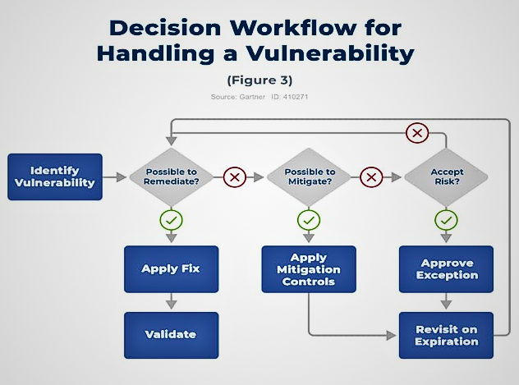
Notes:
Role of Security:
Security professionals play a crucial role in protecting systems and data. They employ ethical hacking techniques to identify vulnerabilities, ensuring that organizations can defend against potential threats and attacks.
Penetration Testing Methodologies:
Various methodologies guide penetration testing, including PTES, OWASP, and NIST. These frameworks provide structured approaches that enhance security assessments, helping organizations establish effective defenses against cyber threats.
Categories of Penetration Tests:
Penetration tests can be categorized based on scope, such as black-box, white-box, and grey-box testing. Each category serves a unique purpose, ensuring comprehensive evaluation of security measures and vulnerabilities.
Legal Framework:
Ethical hackers must navigate a complex legal framework, ensuring compliance with laws and regulations to avoid legal repercussions while conducting penetration tests and vulnerability assessments.
Ethical Concerns:
Ethical considerations are paramount for penetration testers, as they must balance security practices with respect for privacy and integrity, ensuring that their actions do not harm individuals or organizations.
Learning Outcomes:
By the end of this week, students will grasp the fundamentals of ethical hacking, legal boundaries, and frameworks, empowering them to engage confidently in ethical hacking practices.

Slide 18
Best Practices for Hardening Operating Systems
5.1 Windows Hardening
Patch Management:
Deploy security updates promptly using Windows Update or WSUS
For large networks: use Systems Management Server (SMS), Windows Software Update Service (WSUS), or SCCM
Third-party solutions: BigFix, Tanium, BladeLogic
Keep systems updated as attackers exploit known vulnerabilities
Antivirus Solutions:
Essential for all Windows systems
Small networks: desktop antivirus with automatic updates
Large networks: corporate-level solution required
Update antivirus definitions regularly (tools are useless if not updated)
User Account Control (UAC):
Enable and maintain UAC settings
Educate users on prompt approval
Firewall Configuration:
Enable Windows Defender Firewall
Implement host-based intrusion detection
Monitor inbound/outbound connections
Filter ports 137-139 and 445 (against SMB and null session attacks)
Service Hardening:
Disable unnecessary services
Run services with least privilege accounts
Regularly audit service configurations
Remove unused scripts and sample applications
Delete default hidden shares
File System Security:
Enable NTFS encryption (EFS) for sensitive data
Implement BitLocker full disk encryption
Audit and maintain file permissions
Use a file integrity checker like Tripwire
Network Security:
Implement network segmentation
Use appropriate packet filtering with firewalls and Intrusion Detection Systems
Limit administrator accounts
Use different naming schemes and passwords for public interfaces
Ensure password length and complexity requirements
Account Security:
Disable the Guest account
Disable the local Administrator account
Ensure no accounts have blank passwords
Implement strong password policies
Access Control:
AppLocker and Code Integrity for application whitelisting
Enforce code signing policies
Use Windows Group Policies for security enforcement
Monitoring and Logging:
Enable and review logs regularly
Monitor critical areas and traffic patterns
Identify signs of intrusion and problems
Notes:
Role of Security:
Security professionals play a crucial role in protecting systems and data. They employ ethical hacking techniques to identify vulnerabilities, ensuring that organizations can defend against potential threats and attacks.
Penetration Testing Methodologies:
Various methodologies guide penetration testing, including PTES, OWASP, and NIST. These frameworks provide structured approaches that enhance security assessments, helping organizations establish effective defenses against cyber threats.
Categories of Penetration Tests:
Penetration tests can be categorized based on scope, such as black-box, white-box, and grey-box testing. Each category serves a unique purpose, ensuring comprehensive evaluation of security measures and vulnerabilities.
Legal Framework:
Ethical hackers must navigate a complex legal framework, ensuring compliance with laws and regulations to avoid legal repercussions while conducting penetration tests and vulnerability assessments.
Ethical Concerns:
Ethical considerations are paramount for penetration testers, as they must balance security practices with respect for privacy and integrity, ensuring that their actions do not harm individuals or organizations.
Learning Outcomes:
By the end of this week, students will grasp the fundamentals of ethical hacking, legal boundaries, and frameworks, empowering them to engage confidently in ethical hacking practices.

Slide 19
Best Practices for Hardening Operating Systems (Cont’d)
5.2 Linux Hardening
Kernel and Package Updates:
Apply security patches immediately upon release
Subscribe to security advisory lists for your distribution
Use automated patching where possible
Most Linux distributions have warning methods for critical vulnerabilities
Access Control:
Implement the principle of least privilege
Use role-based access control (RBAC)
Restrict SUID binaries to only necessary programs
Configure sudoers carefully using visudo
Firewall Configuration:
Implement iptables/firewalld rules
Enable SELinux or AppArmor mandatory access controls
Monitor firewall logs
Service Hardening:
Disable unnecessary services and daemons
Run services as unprivileged users
Use systemd security features
File System Security:
Implement disk encryption (LUKS)
Set appropriate file permissions
Monitor file integrity with AIDE or Tripwire
Be cautious with the bash_history file permissions
User Awareness Training:
Inform users not to share OS information with outsiders
Users should be suspicious of people asking questions
Educate on verifying identities before sharing information
Vulnerability Assessment:
Use vulnerability scanners regularly
Use built-in Linux tools for security assessment
Implement free benchmark tools from the Center for Internet Security
Notes:
Role of Security:
Security professionals play a crucial role in protecting systems and data. They employ ethical hacking techniques to identify vulnerabilities, ensuring that organizations can defend against potential threats and attacks.
Penetration Testing Methodologies:
Various methodologies guide penetration testing, including PTES, OWASP, and NIST. These frameworks provide structured approaches that enhance security assessments, helping organizations establish effective defenses against cyber threats.
Categories of Penetration Tests:
Penetration tests can be categorized based on scope, such as black-box, white-box, and grey-box testing. Each category serves a unique purpose, ensuring comprehensive evaluation of security measures and vulnerabilities.
Legal Framework:
Ethical hackers must navigate a complex legal framework, ensuring compliance with laws and regulations to avoid legal repercussions while conducting penetration tests and vulnerability assessments.
Ethical Concerns:
Ethical considerations are paramount for penetration testers, as they must balance security practices with respect for privacy and integrity, ensuring that their actions do not harm individuals or organizations.
Learning Outcomes:
By the end of this week, students will grasp the fundamentals of ethical hacking, legal boundaries, and frameworks, empowering them to engage confidently in ethical hacking practices.

Slide 20
Best Practices for Hardening Operating Systems (Cont’d)
5.3 Embedded System Hardening
Firmware Management:
Keep firmware current with the latest security patches
Verify firmware authenticity and integrity
Use secure boot mechanisms
Network Security:
Change default credentials immediately
Disable unnecessary network services
Implement network segmentation
Use VPNs for remote management access
Data Protection:
Encrypt data in transit (TLS/SSL)
Encrypt sensitive data at rest
Secure credential storage
Monitoring and Logging:
Enable logging for administrative access
Monitor for unusual device behavior
Maintain centralized log collection
Alert on suspicious activities
Lifecycle Management:
Identify all embedded systems in the organization
Prioritize systems by function criticality
Plan for end-of-life replacement
Upgrade or replace systems that cannot be secured
Notes:
Role of Security:
Security professionals play a crucial role in protecting systems and data. They employ ethical hacking techniques to identify vulnerabilities, ensuring that organizations can defend against potential threats and attacks.
Penetration Testing Methodologies:
Various methodologies guide penetration testing, including PTES, OWASP, and NIST. These frameworks provide structured approaches that enhance security assessments, helping organizations establish effective defenses against cyber threats.
Categories of Penetration Tests:
Penetration tests can be categorized based on scope, such as black-box, white-box, and grey-box testing. Each category serves a unique purpose, ensuring comprehensive evaluation of security measures and vulnerabilities.
Legal Framework:
Ethical hackers must navigate a complex legal framework, ensuring compliance with laws and regulations to avoid legal repercussions while conducting penetration tests and vulnerability assessments.
Ethical Concerns:
Ethical considerations are paramount for penetration testers, as they must balance security practices with respect for privacy and integrity, ensuring that their actions do not harm individuals or organizations.
Learning Outcomes:
By the end of this week, students will grasp the fundamentals of ethical hacking, legal boundaries, and frameworks, empowering them to engage confidently in ethical hacking practices.

Slide 21
Detection and Remediation
6.1 Rootkit Detection and Removal
6.2 Windows Defender Exploit Guard (Windows 10+)
Rootkit Characteristics:
Modify OS kernel modules, drivers, libraries, or install as applications
Exist for Windows, Linux, and embedded systems
Provide persistent backdoor access across reboots
Can be installed at the factory level, compromising devices before sale
Detection Methods:
Behavioral analysis and monitoring
Kernel integrity verification
Memory forensics
File system analysis
Rootkit-detection tools and antivirus software
Detection Tools:
chkrootkit
rkhunter
GMER
Windows Defender offline scanning
Limitations: If the OS is already compromised, detection tools may be unreliable, as rootkits can hide their presence.
Remediation:
Flash (rewrite) BIOS/firmware to remove kernel-level malware
Wipe the hard drive completely
Reload a clean operating system
Complete system replacement if firmware-level infection suspected
Time-consuming and expensive process
New Security Features (Fall Creators Update onwards):
Attack Surface Reduction (ASR): Uses machine learning to detect and stop zero-day attacks
Network Protection: Blocks outbound connections to known malicious servers
Controlled Folder Access: Prevents unauthorized programs from modifying files in protected folders
Exploit Protection: Guards against memory corruption and code injection attacks
6.3 Incident Response
Upon Suspected Compromise:
Isolate the system from the network
Preserve evidence for forensic analysis
Conduct a memory dump for analysis
Perform comprehensive malware scanning
If rootkit confirmed: complete OS wipe and reload, or hardware replacement
Notes:
Role of Security:
Security professionals play a crucial role in protecting systems and data. They employ ethical hacking techniques to identify vulnerabilities, ensuring that organizations can defend against potential threats and attacks.
Penetration Testing Methodologies:
Various methodologies guide penetration testing, including PTES, OWASP, and NIST. These frameworks provide structured approaches that enhance security assessments, helping organizations establish effective defenses against cyber threats.
Categories of Penetration Tests:
Penetration tests can be categorized based on scope, such as black-box, white-box, and grey-box testing. Each category serves a unique purpose, ensuring comprehensive evaluation of security measures and vulnerabilities.
Legal Framework:
Ethical hackers must navigate a complex legal framework, ensuring compliance with laws and regulations to avoid legal repercussions while conducting penetration tests and vulnerability assessments.
Ethical Concerns:
Ethical considerations are paramount for penetration testers, as they must balance security practices with respect for privacy and integrity, ensuring that their actions do not harm individuals or organizations.
Learning Outcomes:
By the end of this week, students will grasp the fundamentals of ethical hacking, legal boundaries, and frameworks, empowering them to engage confidently in ethical hacking practices.

Slide 22
Ethical Considerations
As ethical hackers, understanding these vulnerabilities enables you to:
Identify security flaws before malicious actors exploit them
Help organizations implement protective measures
Conduct authorized penetration tests to improve security posture
Educate stakeholders about risks and mitigations
Always:
Obtain written authorization before testing any system
Follow responsible disclosure practices
Respect legal and ethical boundaries
Document findings professionally
Notes:
Role of Security:
Security professionals play a crucial role in protecting systems and data. They employ ethical hacking techniques to identify vulnerabilities, ensuring that organizations can defend against potential threats and attacks.
Penetration Testing Methodologies:
Various methodologies guide penetration testing, including PTES, OWASP, and NIST. These frameworks provide structured approaches that enhance security assessments, helping organizations establish effective defenses against cyber threats.
Categories of Penetration Tests:
Penetration tests can be categorized based on scope, such as black-box, white-box, and grey-box testing. Each category serves a unique purpose, ensuring comprehensive evaluation of security measures and vulnerabilities.
Legal Framework:
Ethical hackers must navigate a complex legal framework, ensuring compliance with laws and regulations to avoid legal repercussions while conducting penetration tests and vulnerability assessments.
Ethical Concerns:
Ethical considerations are paramount for penetration testers, as they must balance security practices with respect for privacy and integrity, ensuring that their actions do not harm individuals or organizations.
Learning Outcomes:
By the end of this week, students will grasp the fundamentals of ethical hacking, legal boundaries, and frameworks, empowering them to engage confidently in ethical hacking practices.

Slide 23
References
Here are some helpful online resources. You can also find more resources from the MMU digital library:
Windows Internals (7th Edition), Part 2: Chapter 10 - Windows Services
NIST Cybersecurity Framework:
https://www.nist.gov/cyberframework
Microsoft Security Advisories:
https://learn.microsoft.com/en-us/security-updates
https://msrc.microsoft.com/update-guide
Linux Foundation Security Hardening Guidelines:
https://www.linuxfoundation.org/lf-security
OWASP IoT Top 10 and IoT Security Resources
https://owasp.org/www-chapter-toronto/assets/slides/2019-12-11-OWASP-IoT-Top-10---Introduction-and-Root-Causes.pdf
Notes:
Role of Security:
Security professionals play a crucial role in protecting systems and data. They employ ethical hacking techniques to identify vulnerabilities, ensuring that organizations can defend against potential threats and attacks.
Penetration Testing Methodologies:
Various methodologies guide penetration testing, including PTES, OWASP, and NIST. These frameworks provide structured approaches that enhance security assessments, helping organizations establish effective defenses against cyber threats.
Categories of Penetration Tests:
Penetration tests can be categorized based on scope, such as black-box, white-box, and grey-box testing. Each category serves a unique purpose, ensuring comprehensive evaluation of security measures and vulnerabilities.
Legal Framework:
Ethical hackers must navigate a complex legal framework, ensuring compliance with laws and regulations to avoid legal repercussions while conducting penetration tests and vulnerability assessments.
Ethical Concerns:
Ethical considerations are paramount for penetration testers, as they must balance security practices with respect for privacy and integrity, ensuring that their actions do not harm individuals or organizations.
Learning Outcomes:
By the end of this week, students will grasp the fundamentals of ethical hacking, legal boundaries, and frameworks, empowering them to engage confidently in ethical hacking practices.

Slide 24
Summary
Operating systems (Windows, Linux, Embedded) are vulnerable in different ways.
Many real-world attacks exploit misconfigurations, not just CVEs.
Embedded devices are critical yet under-secured and hard to patch.
Ethical hackers must:
Identify flaws before attackers do.
Educate on risks and mitigations.
Apply responsible and legal testing.
Notes:
Role of Security:
Security professionals play a crucial role in protecting systems and data. They employ ethical hacking techniques to identify vulnerabilities, ensuring that organizations can defend against potential threats and attacks.
Penetration Testing Methodologies:
Various methodologies guide penetration testing, including PTES, OWASP, and NIST. These frameworks provide structured approaches that enhance security assessments, helping organizations establish effective defenses against cyber threats.
Categories of Penetration Tests:
Penetration tests can be categorized based on scope, such as black-box, white-box, and grey-box testing. Each category serves a unique purpose, ensuring comprehensive evaluation of security measures and vulnerabilities.
Legal Framework:
Ethical hackers must navigate a complex legal framework, ensuring compliance with laws and regulations to avoid legal repercussions while conducting penetration tests and vulnerability assessments.
Ethical Concerns:
Ethical considerations are paramount for penetration testers, as they must balance security practices with respect for privacy and integrity, ensuring that their actions do not harm individuals or organizations.
Learning Outcomes:
By the end of this week, students will grasp the fundamentals of ethical hacking, legal boundaries, and frameworks, empowering them to engage confidently in ethical hacking practices.

Slide 25


Thank You
ANY QUESTIONS?

